Slide 1

Request for Quotation 190184
Insourcing Solenoid Armature
06.06.2024
A07591000A / Bosch RzP
Ansprechpartner Gluth:
Ansprechpartner Bosch RzP:
Bernhard Hacker
Technical Sales
E-Mail: hacker.bernhard@gluth.eu
Tel : +49 9421 / 544-19
Mobil : +49 151 / 1402 8680
Fabien Brault
Mechanical Engineering
E-Mail: brault.fabien@gluth.eu
Tel : +49 9421 / 544-78
William Bauguil
Planner
RzP/MFE1
E-Mail: william.bauguil@fr.bosch.com
Tel : +33 5 6567-9485
Mobil : +33 6 34 26 44 81
Sara Gohier
Purchaser
GS/PUI5-TME2
E-Mail: sara.gohier@ro.bosch.com
Tel : +40 722 358 050

Slide 2
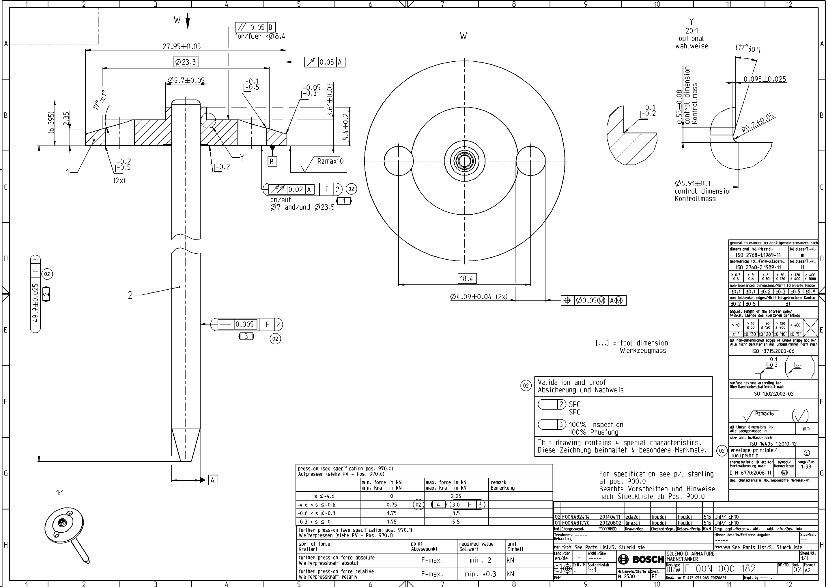
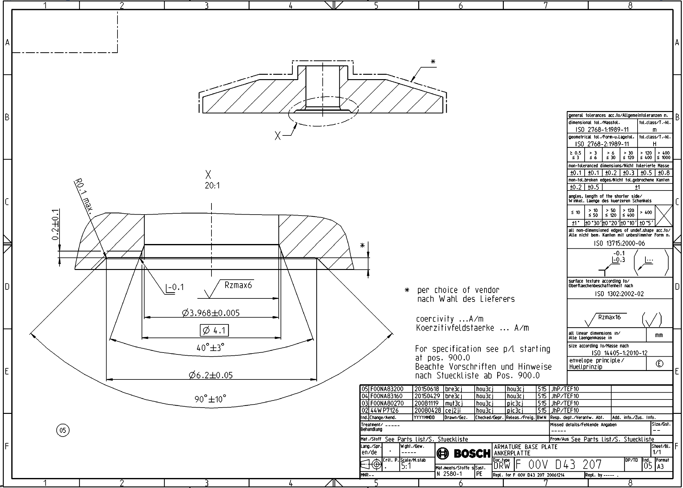
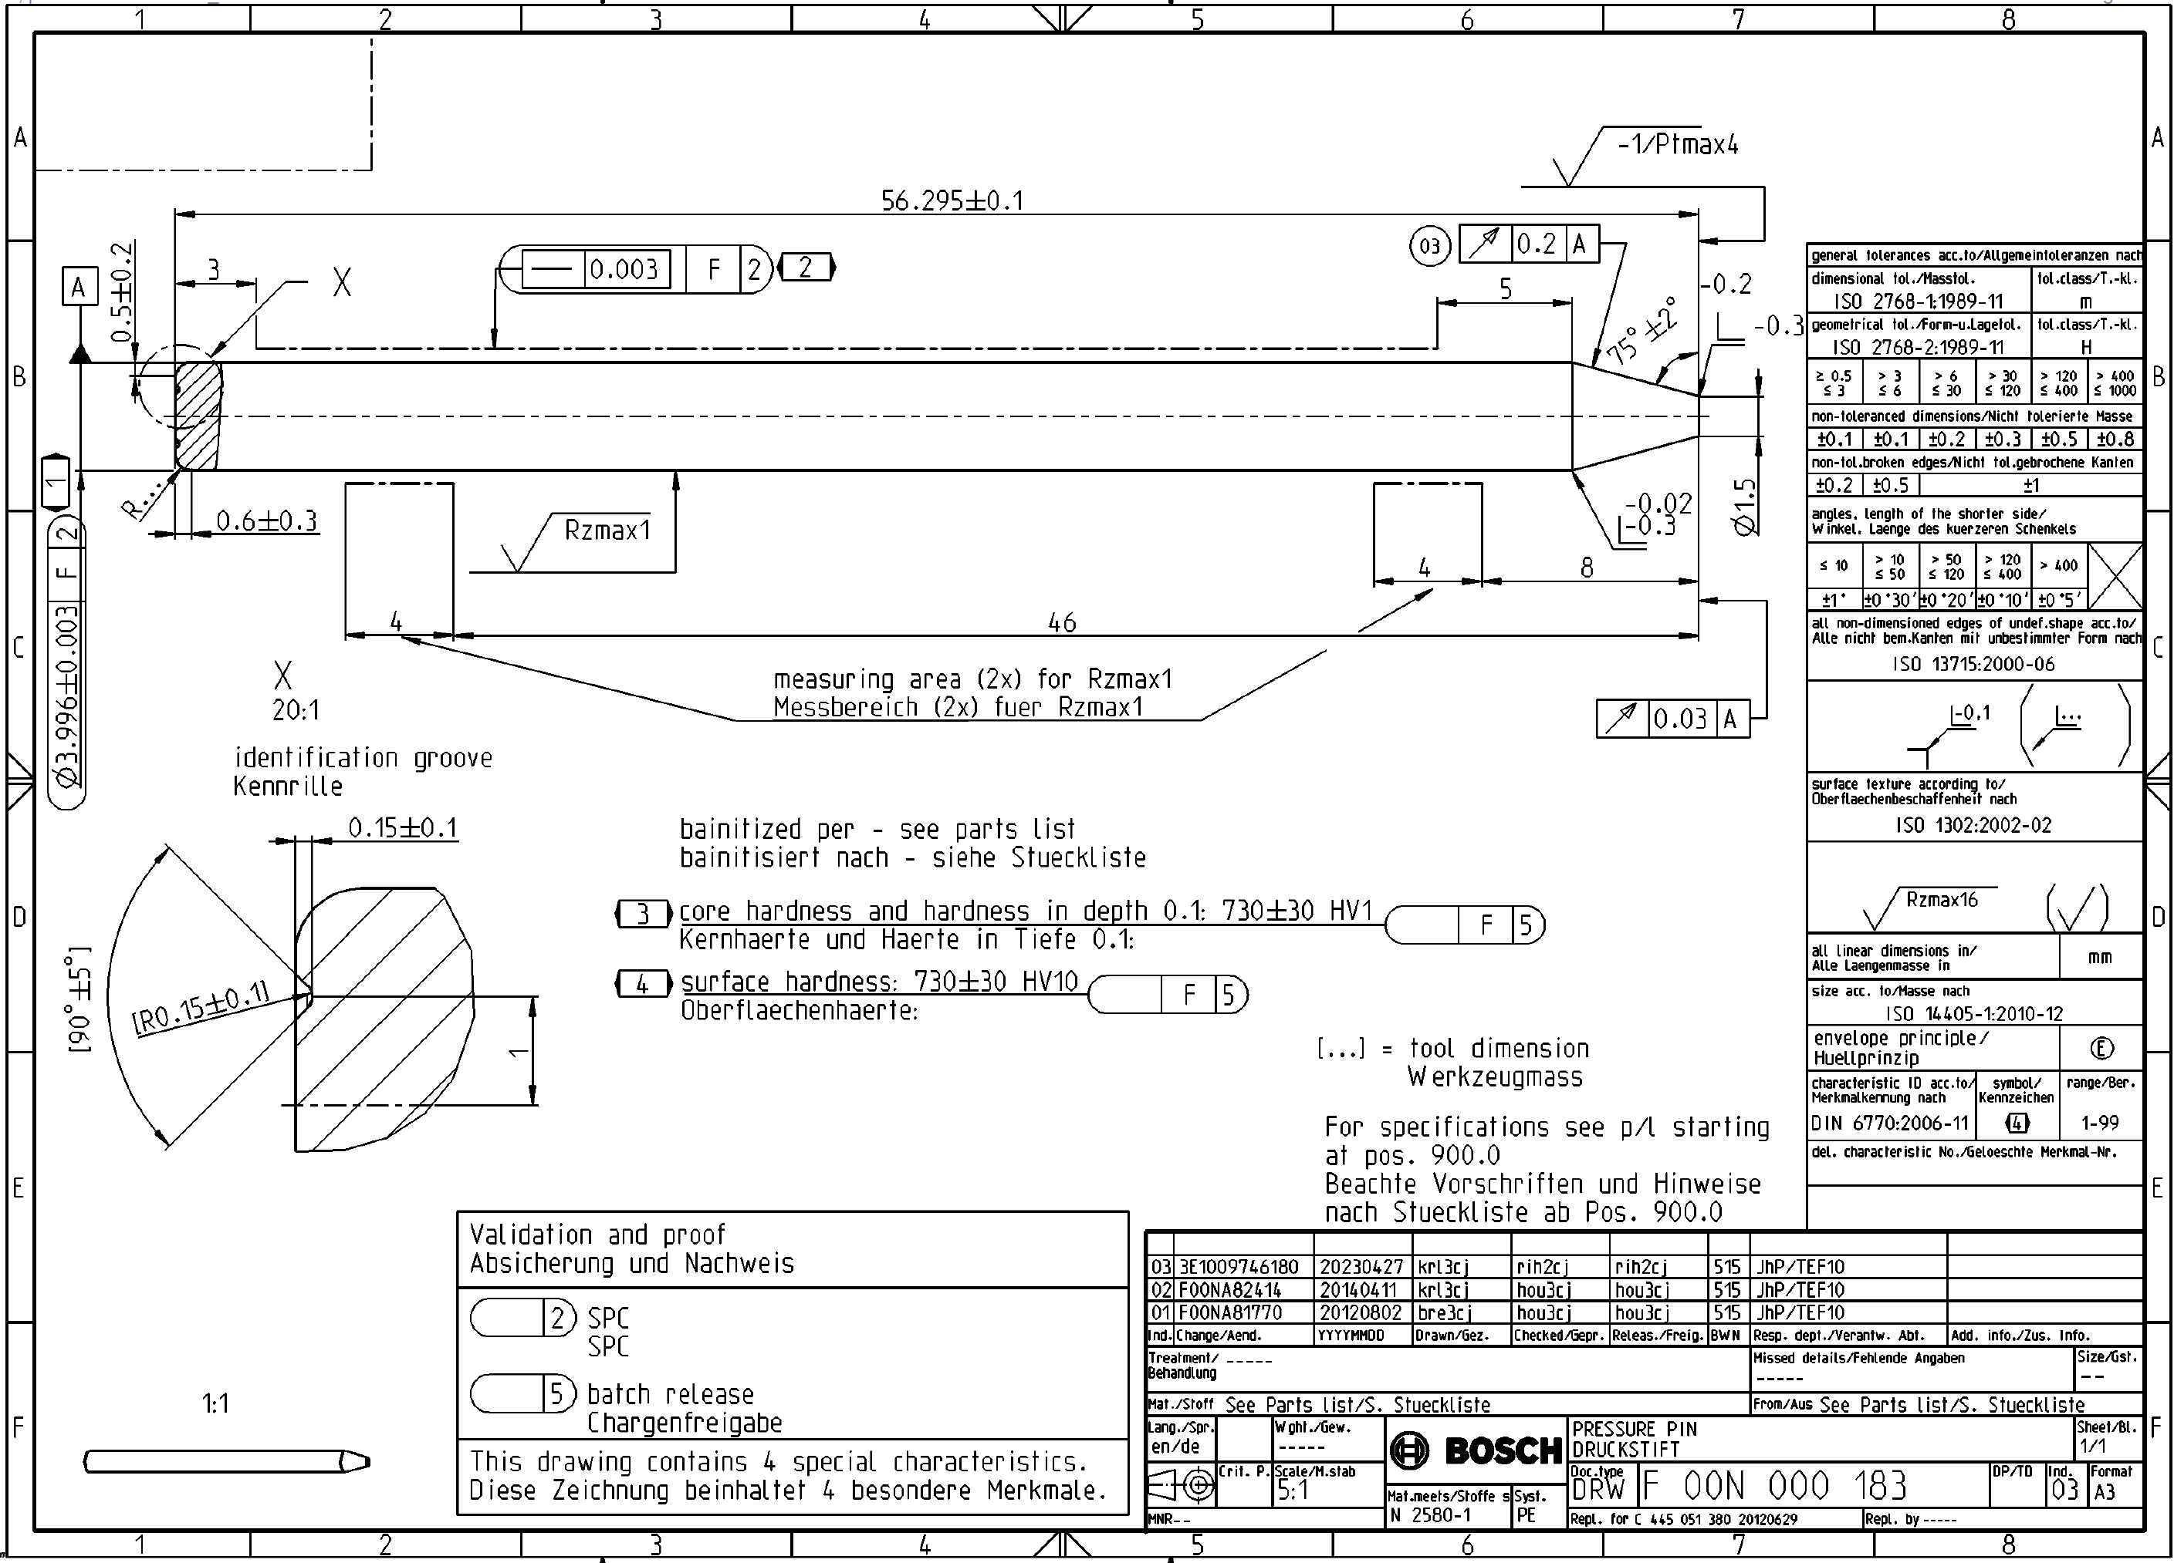
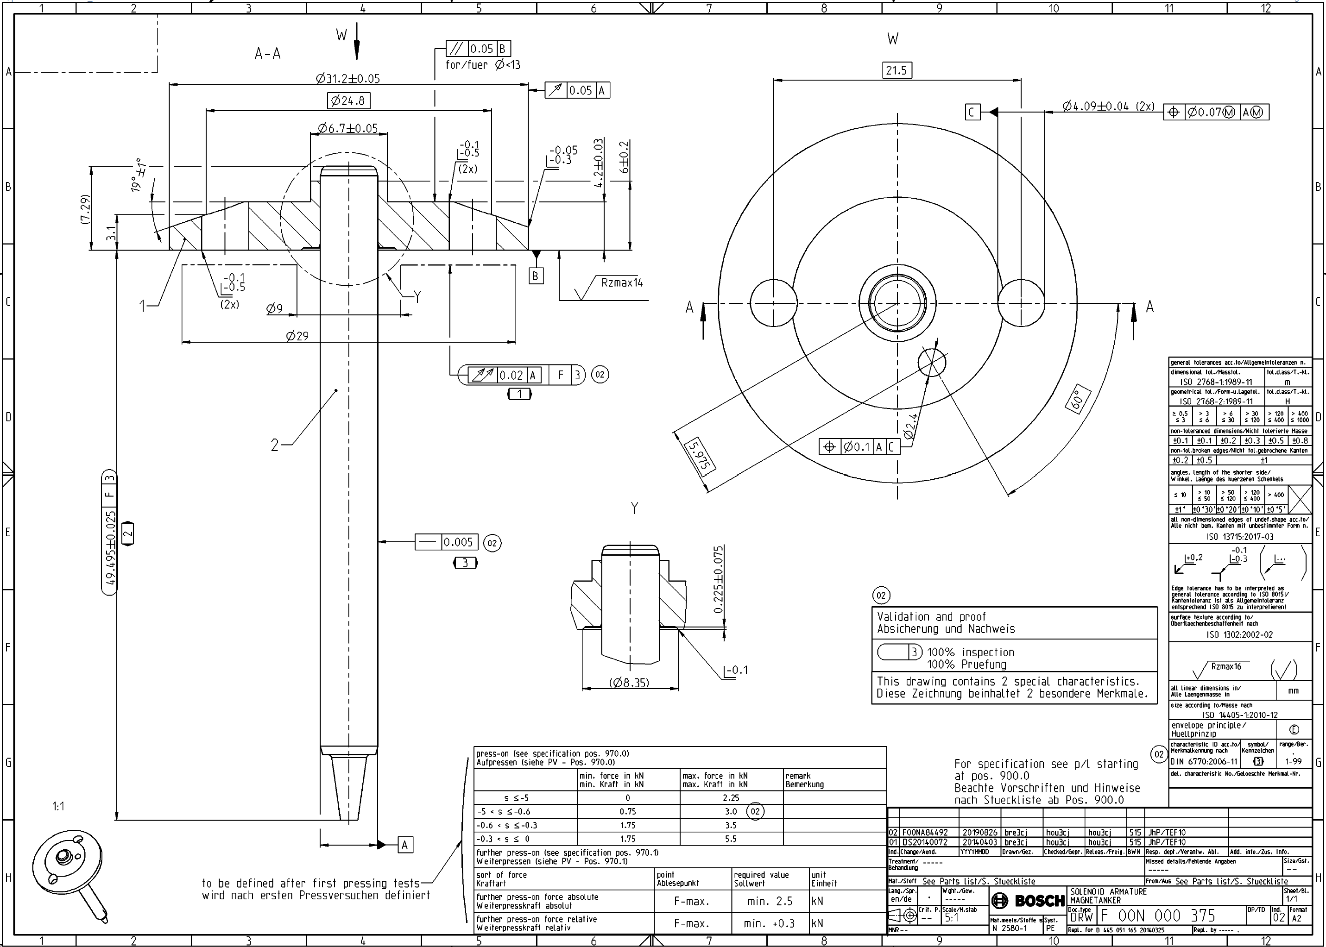
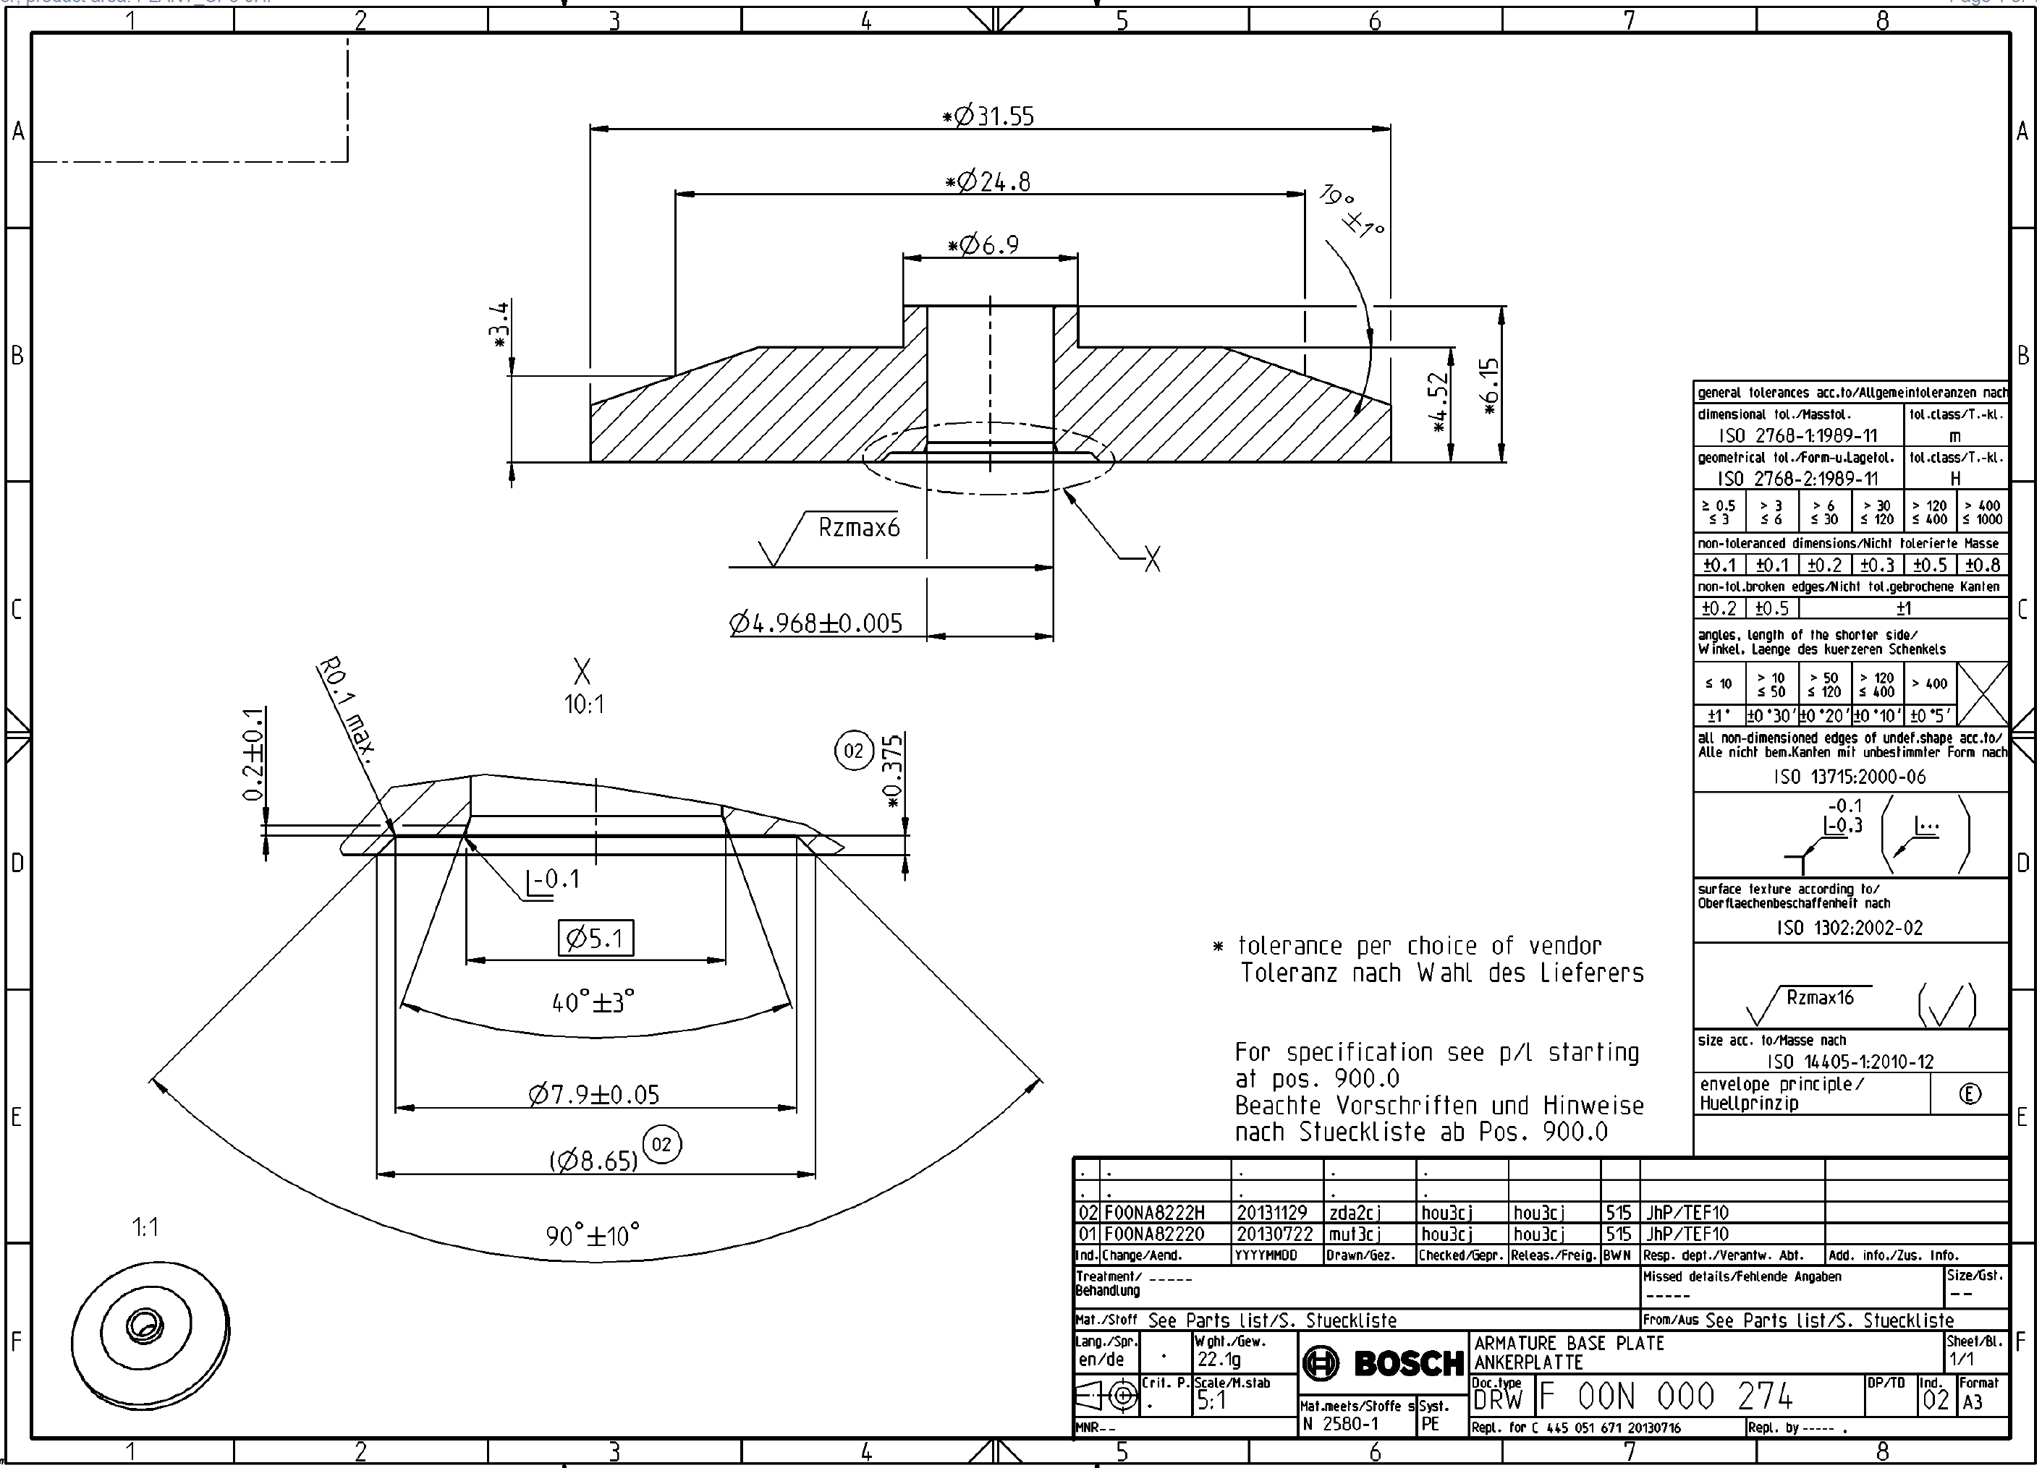
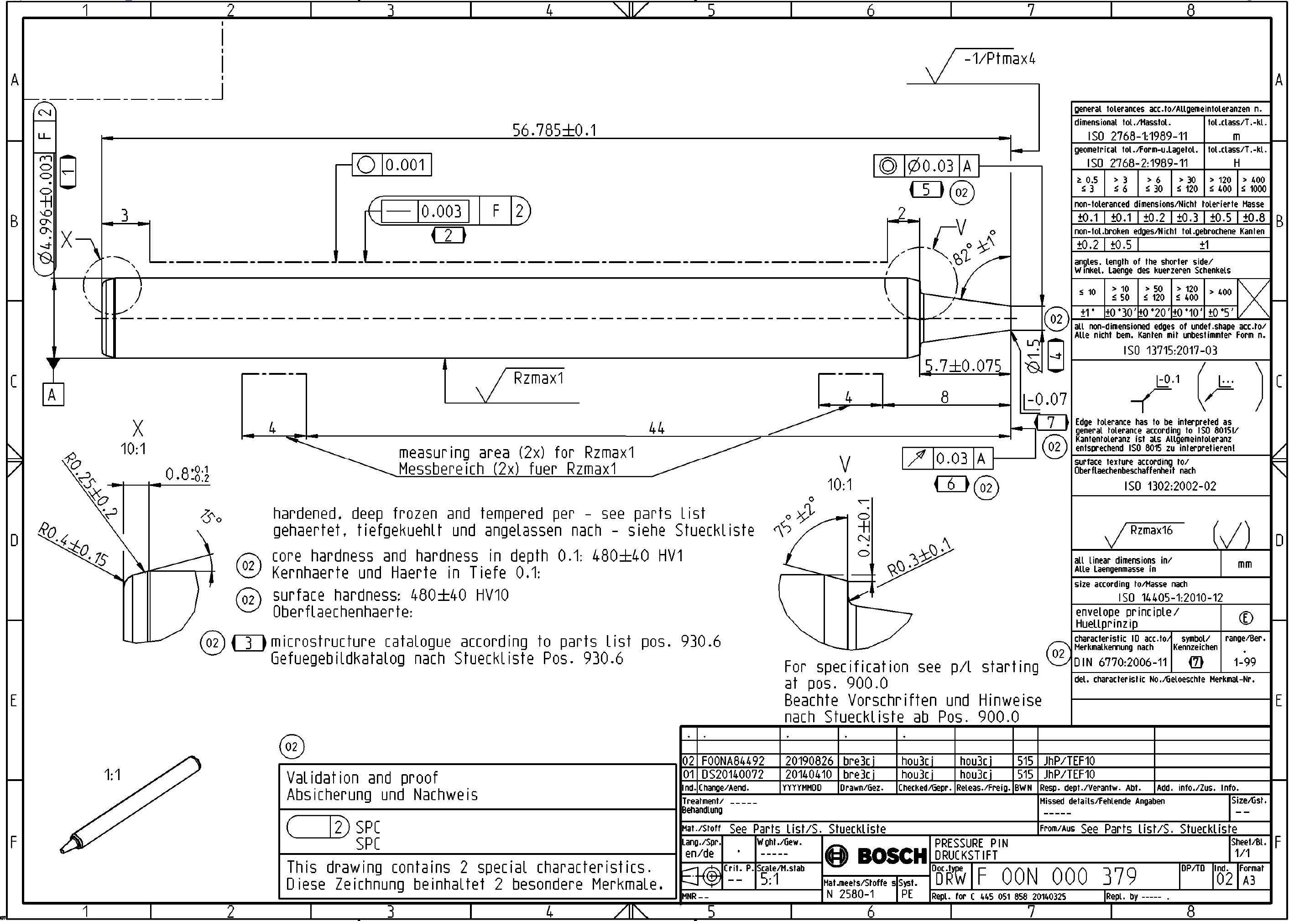
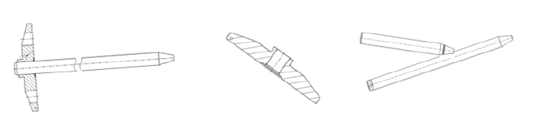
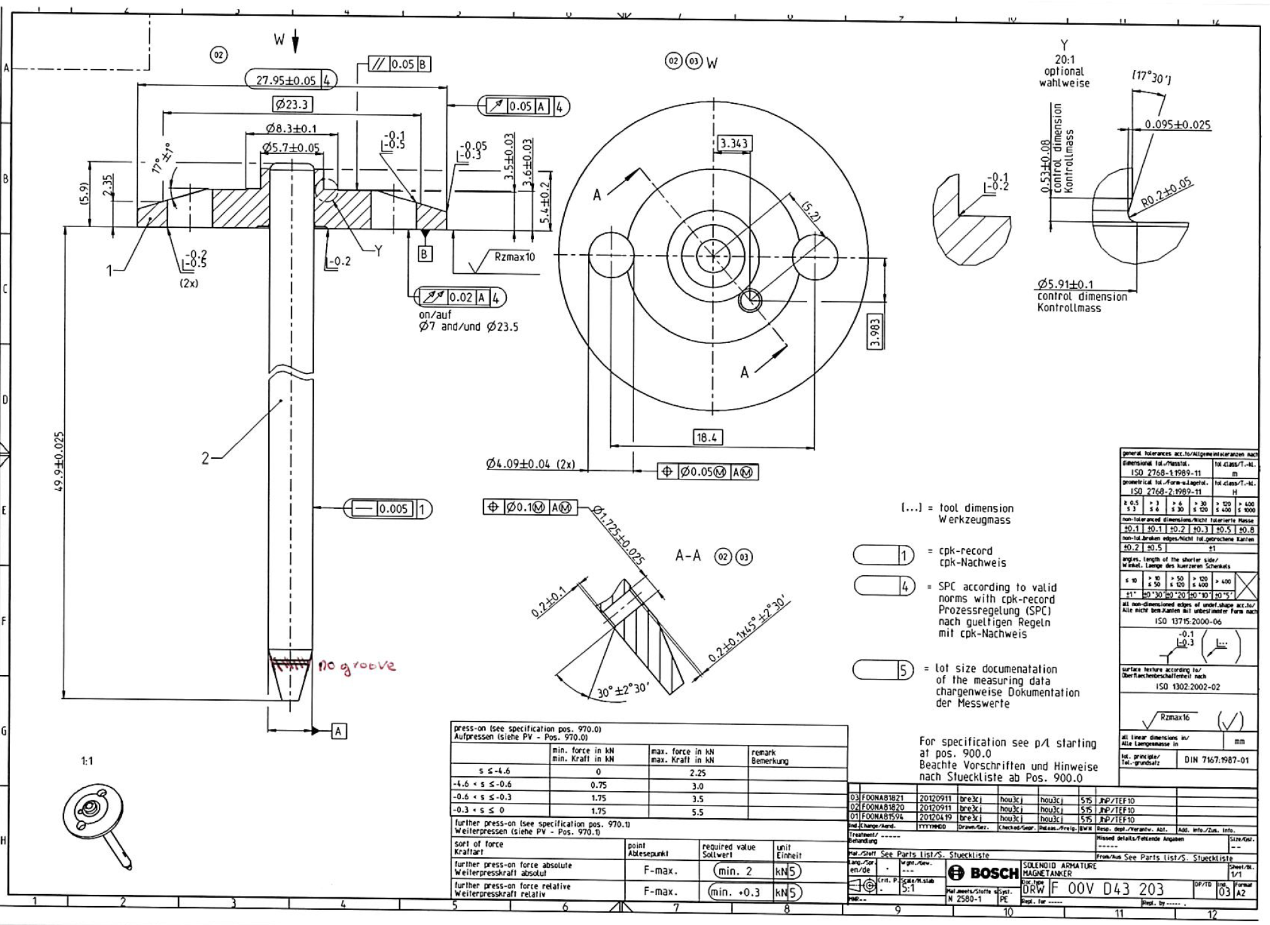
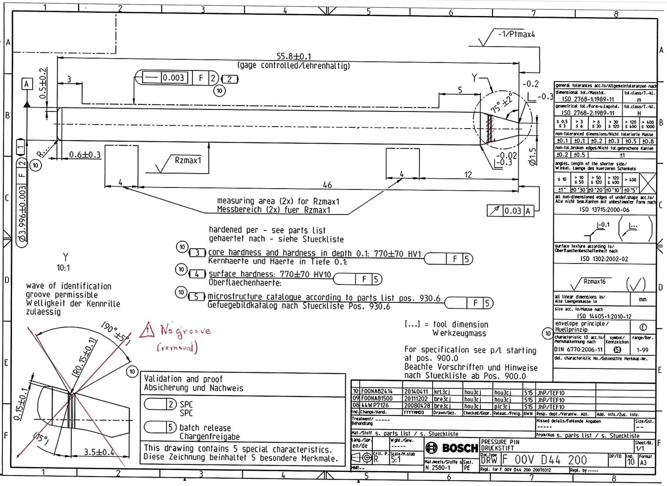
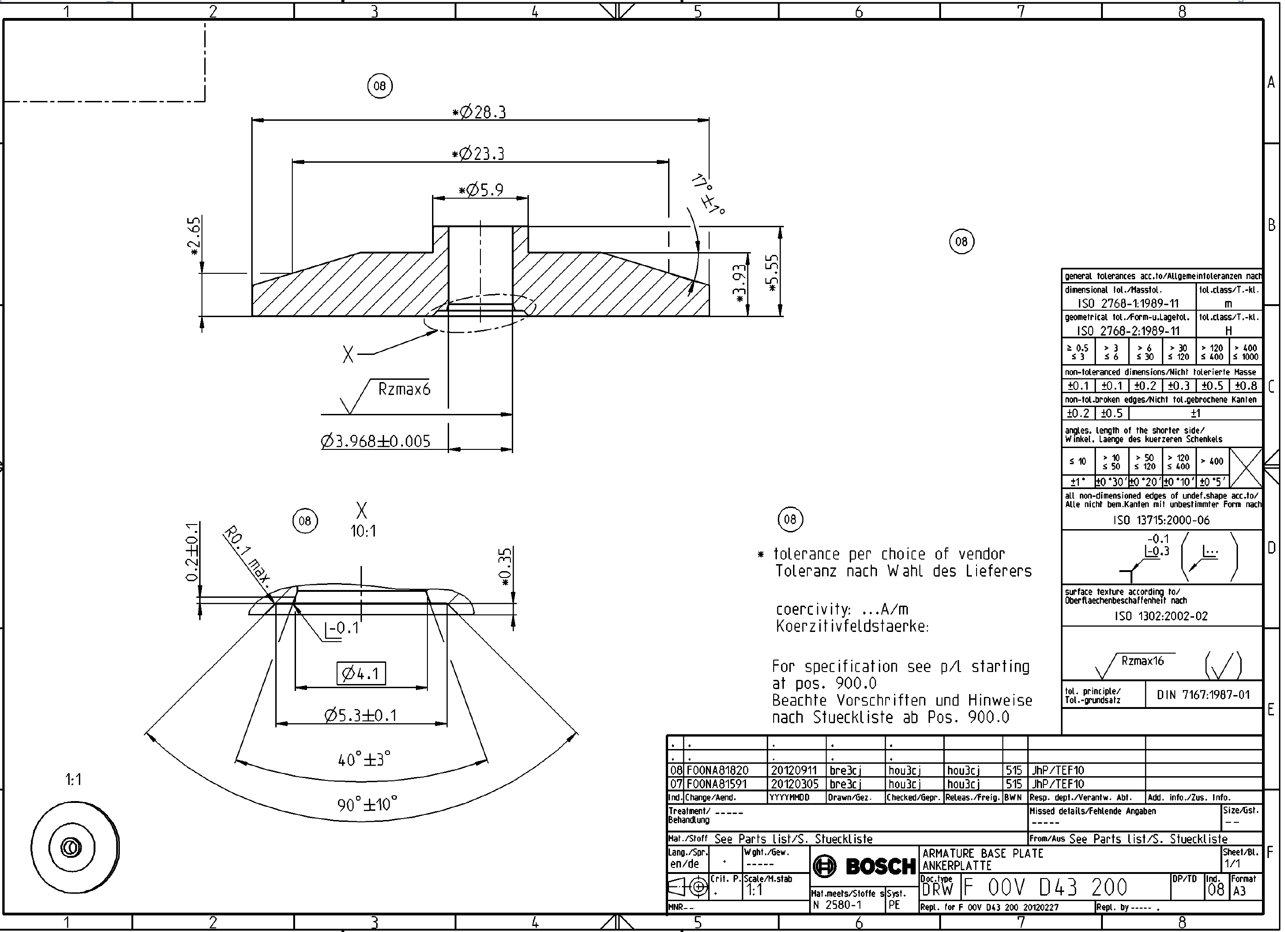
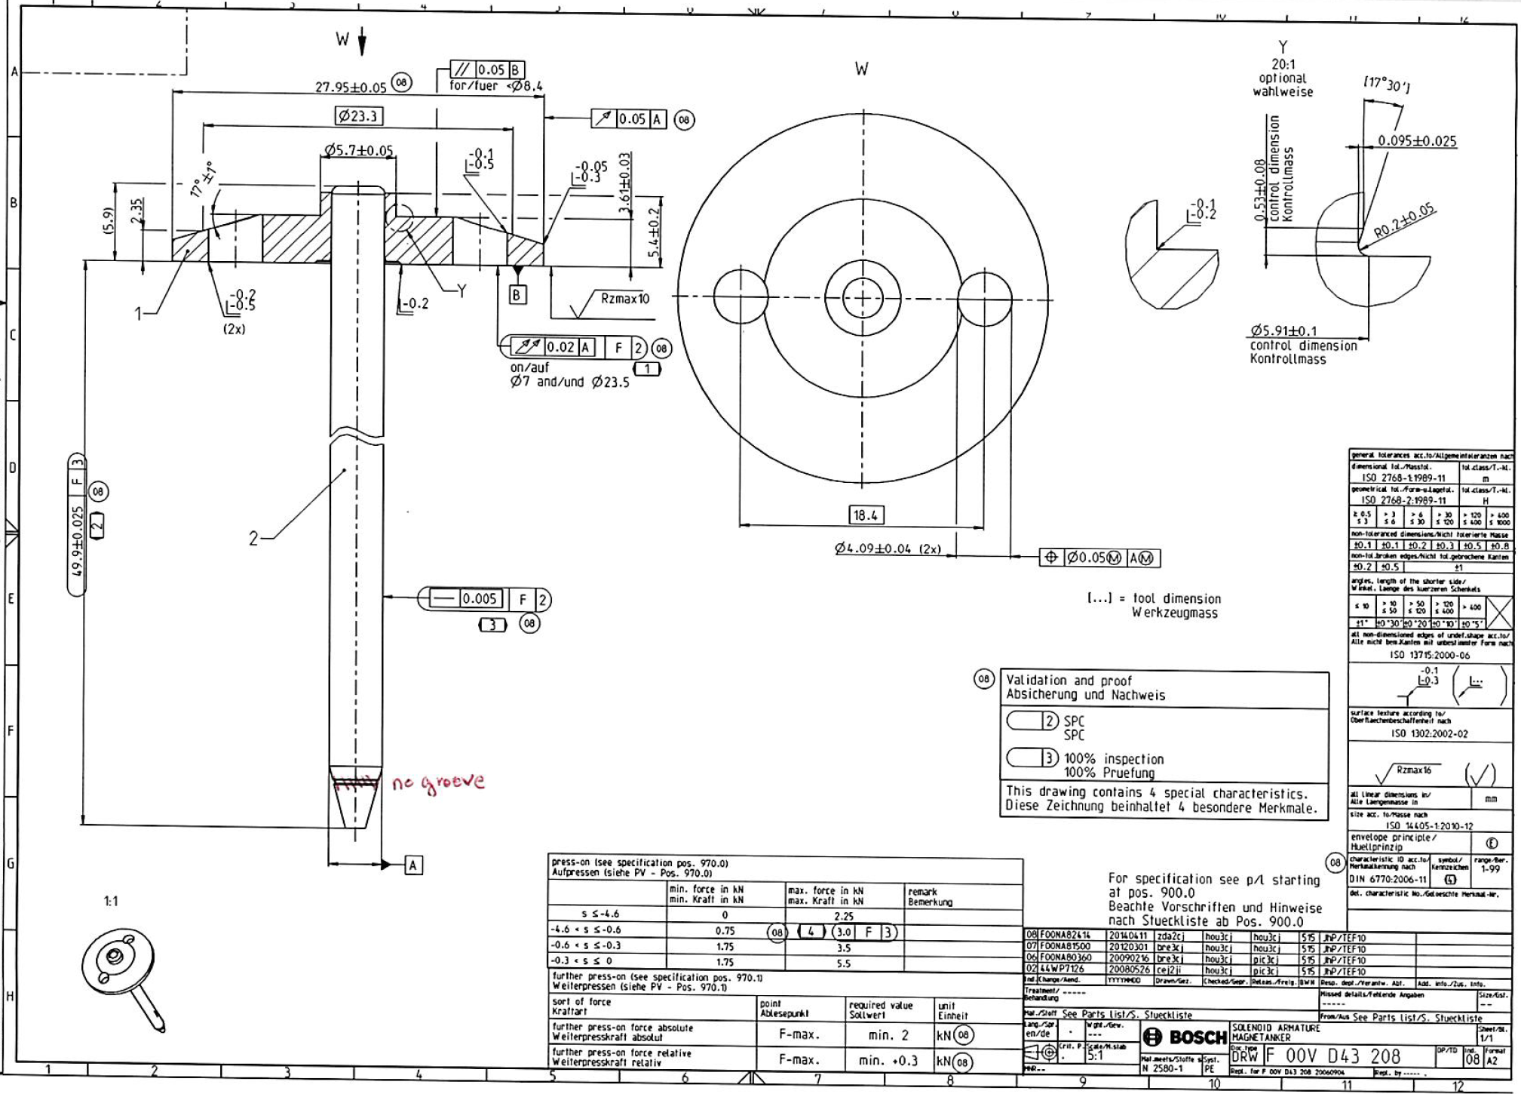
Products solenoid armature
Parts name | Assembled part reference | Plate reference | Pin reference
Solenoid armature | F 00N 000 182 | F 00V D43 207 Ø27,95mm, h5,4mm | F 00N 000 183 Ø4mm, L56,295mm
 | F 00N 000 375 | F 00N 000 274 Ø31,2mm, h6mm | F 00N 000 379 Ø5mm, L56,785mm
 | F 00V D43 203 | F 00V D43 200 Ø27,95mm, h5,4mm | F 00V D44 200 Ø4mm, L55,8mm
 | F 00V D43 208 | F 00V D43 207 Ø27,95mm, h5,4mm | F 00V D44 200 Ø4mm, L55,8mm
Cycle time: 8,2s
Basis of our offer:
Your specification ‚CDC solenoid armature assembly V1‘ from 02.04.2024
Your process parameters F 00V D39 030 & F 00V D39 031
Phone call Brault/Bauguil on 07.06.2024
Former concept of M.Waas

Slide 3
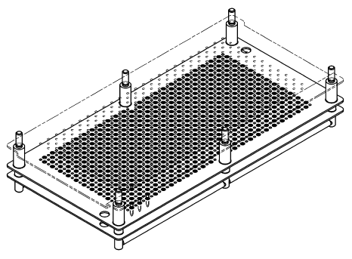
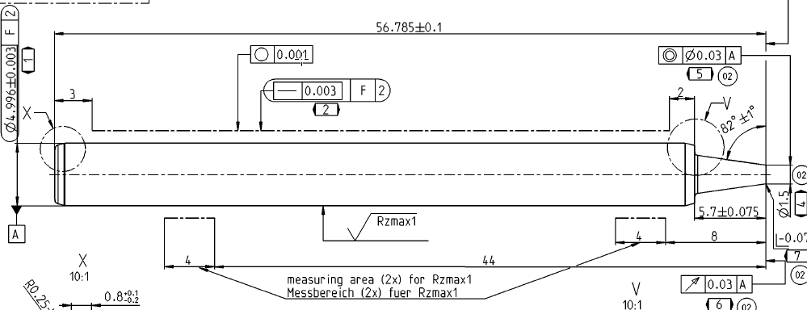
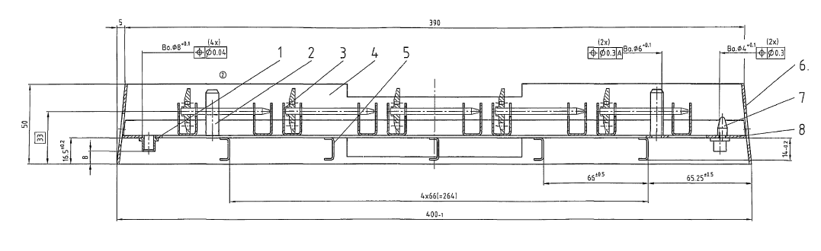
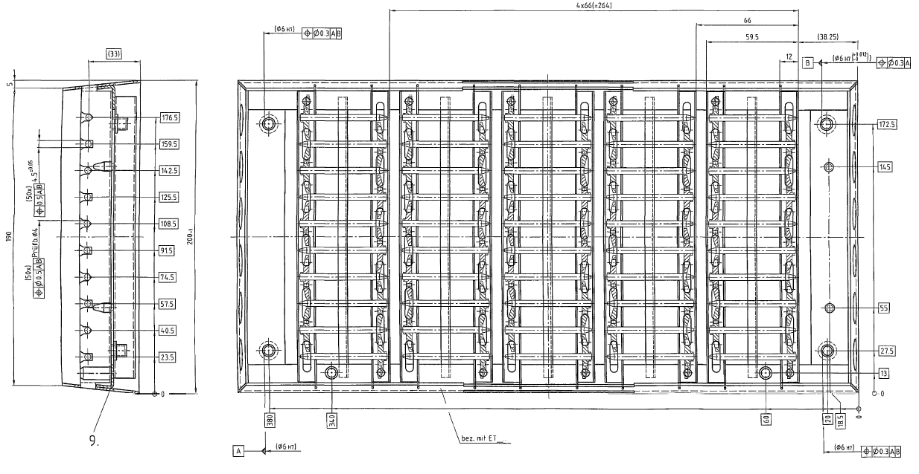
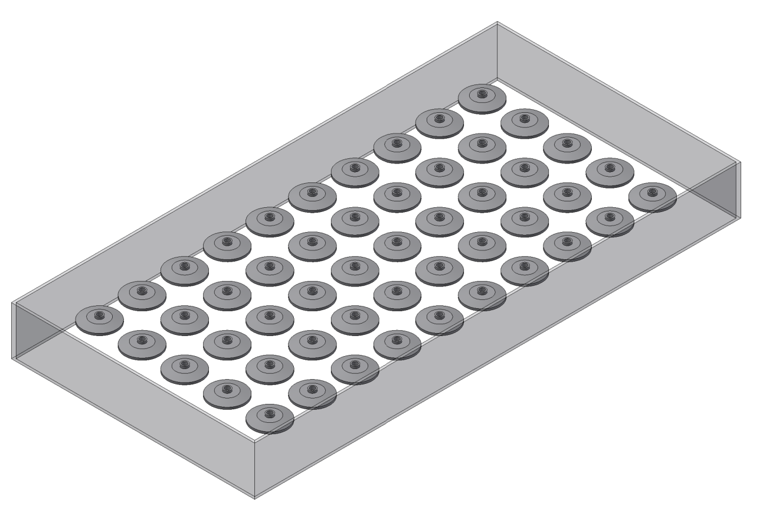
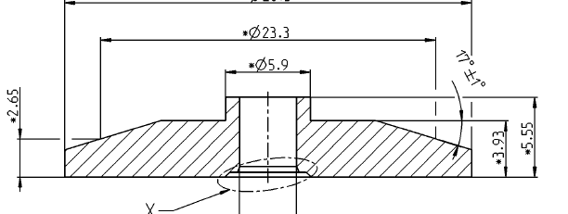
loading & unloading trays
Tray pin
ET_0746W004
One tray per class, three classes
Alarm & light, if tray empty
Tray plate
To be defined
Tray solenoid armature
ET_0830W001
06.06.2024: meeting with Mr.Bauguil:
Tray aus steel (cleaning duty)
50 parts, ca. 400x200mmm
Parts on the B-surface in tray
Poka Yoke between trays Ø27,95 & Ø31,2 nice to have
Compatible with conveyor

Slide 4
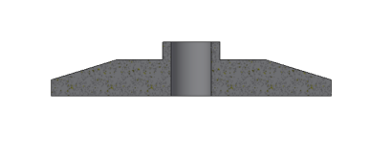
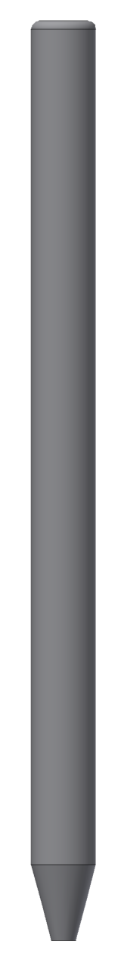
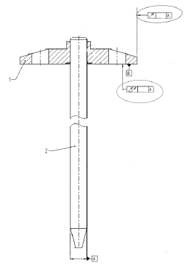
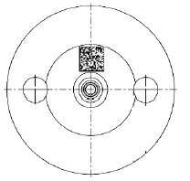
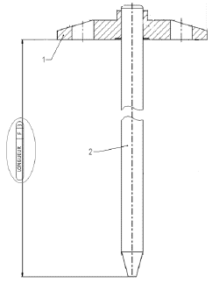
Required Processes
1
2
3
4
5
6
7
8
 | Processes
1 | feeding trays plate
2 | loading plate
3 | plate brushing
4 | hole plate measurement
5 | feeding trays pins
6 | selection needle & loading in assembly tool
7 | loading plate in assembly tool
8 | press fitting
9 | runout checking
10 | length checking
11 | back brushing
12 | DMC marking (option)
13 | DMC controlling (option)
14 | free place
15 | unloading solenoid armature (iO & NiO)
16 | output trays solenoid armature
I
II
III
9
10
11
12
13
14
15
16
empty
options

Slide 5
Required Processes (specifications V2)
 | Processes
1 | feeding trays plate
2 | loading plate
3 | plate brushing
4 | hole plate measurement
5 | feeding trays pins
6 | selection needle & loading in assembly tool
7 | loading plate in assembly tool
8 | press fitting
9 | runout checking
10 | length checking
11 | back brushing
12 | DMC marking
13 | DMC controlling
14 | free place
new | oil washing solenoid armature
new | cleaning solenoid armature (compressed air)
15 | unloading solenoid armature (iO & NiO)
16 | output trays solenoid armature
new | output trays solenoid armature in KLTs
Not only 1 tray pro class, at least 2. The machine has to product without interruption, as the operator is changing a tray
Not only length between plate and pin, but also total length of the pin
molded plastic Trays, no more ET_0830W001. Parts still horizontal

Slide 6
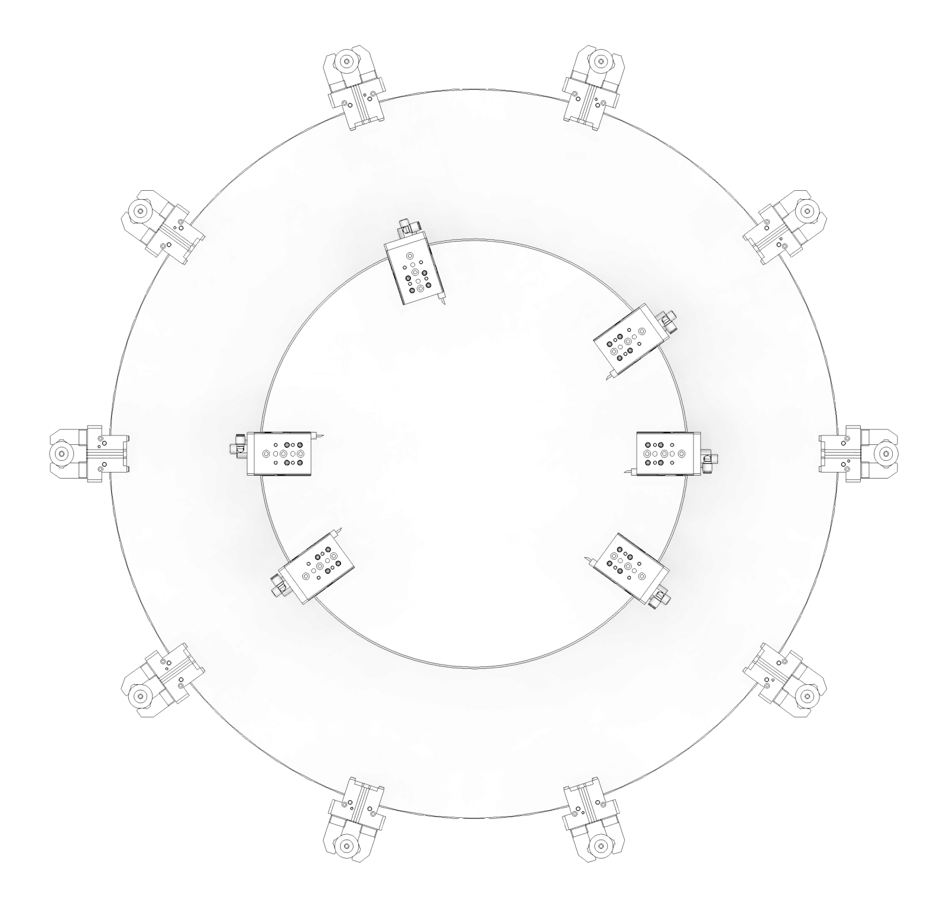
Transport unit (without options)
c
d
 | Positions round table
a | loading plate
b | plate brushing
c | hole plate measurement
d | empty (measered value to handling pins)
e | loading pin in assembly tool & press fitting
f | runout checking
g | length checking
h | back brushing
i | empty (free place)
j | unloading solenoid armature (iO & NiO)
b
e
a
f
j
g
i
h

Slide 7
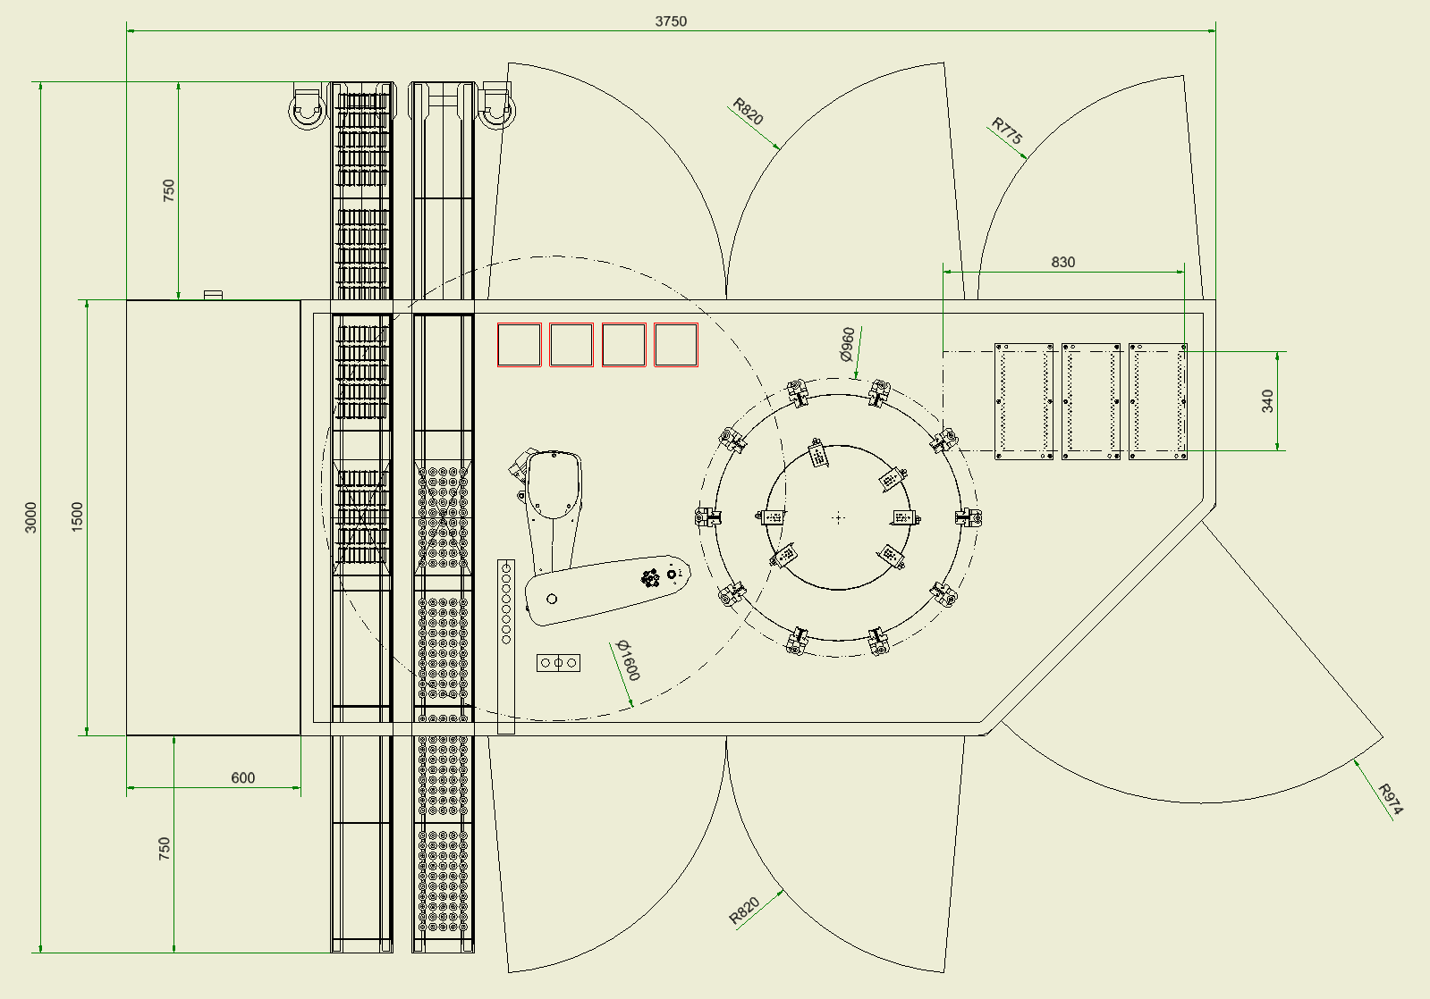
Layout
 | Stations
1 | feeding trays plate
2 | loading plate
3 | plate brushing
4 | hole plate measurement
5 | feeding trays pins
6 | selection needle & loading in assembly tool
7/8 | loading plate in assembly tool & press fitting
9 | runout checking
10 | length checking
11 | back brushing
12 | Angle orientation solenoid armature before marking (option)
13 | DMC marking (option)
14 | free place
15 | unloading solenoid armature (iO & NiO) DMC controlling (option)
16 | output trays solenoid armature
19 | transport unit
20 | boxes NiO-Parts
21 | drawer SPC-Parts
22 | stabi-parts
23 | base frame
24 | controls & electrics
25 | pneumatics
20
4
6
5
3
2/15
7/8
9
19
10
24
14
11
22
21
23
16
1

Slide 8
Price indication
Total price:
Complete machine: 1.150.000€
Without option
Including re-commissioning in Rodez
RzP-Provisions are:
  Complete measurement equipment Plate-InnerØ (Stotz, measurement devices, pneumatics,…) incl. BCI-OpConPlus-Object
Option DMC-Marking: 97.000€
Including
  12-fold-round table instead of 10-fold-round table
  Angle Orientation before DMC-Marking
  DMC-Marking
  Control DMC
RzP-Provisions are:
  Complete Trumpf laser for DMC-marking (used from old Gluth-MAE „lasermarking nozzle, Order 4774) incl. BCI-OpConPlus-Object
  Complete Cognex camera equipment for Angle Orientation (used from old Gluth-MAE „lasermarking nozzle, Order 4774)
  Complete Cognex camera equipment for Control (used from old Gluth-MAE „lasermarking nozzle, Order 4774)

Slide 9
Danke
für die Aufmerksamkeit

